Slide 1

SystemLink Cloud: an Introduction
Presented by David Thomson, PhD
Original Code Consulting LLC
dthomson@originalcode.com
www.originalcode.com
www.originalcode.com

Slide 2
WebVI – Why?
CU Atmospheric Test Chamber – status webpage
Replacement for Data Dashboard running on an Android tablet
Web page accessible from any device with a web browser
Now (finally!) able to create a full web page from within LabVIEW
www.originalcode.com

Slide 3
What is SystemLink Cloud?
LabVIEW NXG
SystemLink
Web Browser
NI Package Manager
LabVIEW 2015
Helium
SystemLink Cloud
Tags
SystemLink Client
WebVIs
NXG Web Module
NI Web Server
Messages
SystemLink Server
API Key
Skyline
www.originalcode.com

Slide 4
New NI Technologies
SystemLink – new software tool for managing distributed systems of hardware, software, and data
  http://www.ni.com/en-us/shop/select/application-software-for-data-acquisition-and-control-category
NI Package Manager – new tool for deploying NI (and other) software
  (Eventually replacing VIPM?)
  Need this for almost all software technologies described in this presentation
SystemLink Server – server software for running SystemLink and a whole lot of other stuff…uh…
SystemLink Client – a smaller package of software for using SystemLink stuff from the client perspective…uh…uh…
www.originalcode.com

Slide 5
New NI Technologies, cont…
SystemLink Cloud – a new tool for hosting SystemLink stuff on NI’s servers and for…uh…uh…stuff with API Keys, and uh…
  NOTE: This is a Tech Preview program. It has not been officially released yet.
Skyline Data Services – a new set of APIs for sharing data across applications and devices (e.g. networked)
  Tags (most recent value, DBL, INT, STR)
  Messages – strings - ???
  Maybe also includes Files???
www.originalcode.com

Slide 6
WebVIs
Finally! We can build web pages in LabVIEW!
WebVI is a special entity in NXG, not the same as a GVI
A WebVI is built into a web page using a special distribution
Can add CSS, HTML, Javascript etc. to a WebVI
WebVIs can be built in LV NXG 2.x
  (SystemLink Cloud requires LV NXG 2.1)
Must have a license for the NXG Web Module
www.originalcode.com

Slide 7
WebVIs
Can host a WebVI on ANY webserver...
…unless you want to use Skyline Data Services!
In which case you must host it on NI Web Server with SystemLink Server or on SystemLink Cloud
  (Currently, there is no tool to install the Skyline Data Services Server other than the NI Web Server Installer)
SystemLink has many other features, and is not really intended for just casual web page hosting
  10 seat access license is $2000/yr – 25 set is $5000/yr, perpetual licenses are 2 or 2.5 times that
www.originalcode.com

Slide 8
SystemLink Cloud
Currently a Tech Preview program
WebVI hosting in the cloud
Included with Web Module
Can host 20 WebVIs, 10,000 Tags, and unlimited Messages
Your SystemLink Cloud account (in the system referred to as Helium) is linked to your NI.com credentials
www.originalcode.com

Slide 9
Security
Can limit access to a WebVI by requiring the account’s NI.com credentials
Or can make a WebVI public and open to anyone with the URL
Can limit access to various Tags and Messages by linking them to an API Key which has policies defined for it
www.originalcode.com

Slide 10
How to Create a Working WebVI
Join the Tech Preview: http://www.ni.com/en-us/support/software-technology-preview.html (tell them ALARM sent you)
Get an account on Helium: https://www.systemlinkcloud.com/
Download and install NXG 2.1 and the NXG API using NI Package Manager: https://www.systemlinkcloud.com/api-download
Get an API Key: https://www.systemlinkcloud.com/security
Store your API Key someplace safe, you are only shown it once!
www.originalcode.com

Slide 11
How to Create a Working WebVI
Use NXG to create a WebVI
  I use Tags to transfer data from LabVIEW to the WebVI
Build the WebVI into a Package
Upload the Package to the SystemLink Cloud: https://www.systemlinkcloud.com/webapphosting
Run the link for the WebVI in a web browser
www.originalcode.com

Slide 12
How to Send Data Between your WebVI & LV
I wanted to send data to a web page from LV 2015
Luckily, LV 2015 IS supported by Skyline Data Services. (It is the oldest supported version of LV)
Install the Skyline API by (I think…) installing the SystemLink Client using NI Package Manager (this was an extra step for me, since my LV 2015 is not on the same machine as NXG)
Inside LV 2015, you need an off-palette Open VI to use SystemLink Cloud instead of SystemLink:
  C:\Program Files (x86)\National Instruments\LabVIEW [Version]\vi.lib\Skyline\Configuration\Configuration HTTP_class\Open Configuration API Key.vi
  https://github.com/ni/webvi-examples/tree/master/UtilizeSkylineDataServices
www.originalcode.com

Slide 13
How to Build the Web App
File/New/Distribution
On the Document tab of the Distribution, select Web Server as Target
Select Package for Output Type
On the Distribution tab, press the Add button for Applications/Libraries
Add Company and Product info, etc.
Save all
Build
www.originalcode.com

Slide 14
Example Time…
www.originalcode.com

Slide 15
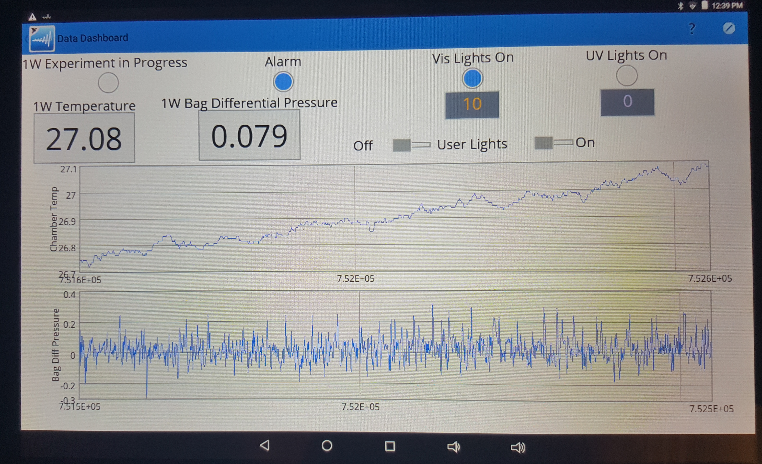
DataDashboard
www.originalcode.com

Slide 16
Caveats and Issues
There are Multi-Read and Multi-Write VIs to allow a single html POST to handle multiple tags
  This is supposed to improve performance
  In NXG, you can define the “group” and then add values to it later
  I haven’t tested the performance there yet…
  In LV 2015, you create the “group” with their values, e.g. every time you do the Multi-Write
  This is slow!
  This may get better. Skyline is young. But how much support they’ll put into LV 2015????
www.originalcode.com

Slide 17
Caveats and Issues
Limited functionality in NXG/WebVIs
  No event structure
  No property nodes
  Limited graphing functionality
www.originalcode.com

Slide 18
Advantages
Should continue to improve and be supported
DataDashboard was limited in range by network access to the Shared Variables (there are ways to fix this…) whereas the Cloud is accessible across the Internet
Can program logic behind the front panel
It’s LabVIEW!!!!
www.originalcode.com

